Slide 1
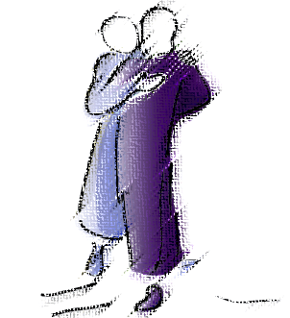
Loving God,
Help me to prepare to meet you in a special way in the sacrament of reconciliation.
Open my heart and give me courage that I might honestly prepare.
Through Christ our Lord
Amen
Notes:
Leader: Let us pray for courage to make a good reconciliation (pray together the pray on the PP)
Let us pray a blessing for each of us as we prepare to celebrate the great Sacrament of Reconciliation on Tuesday evening as a family form a circle, hold hands and say together
Glory be to the Father and to the Son and to the Holy Spirit as it was in the beginning is now and always shall be. Amen

Slide 2
Glory be to the Father
and to the Son
and to the Holy Spirit
as it was in the beginning is now and always shall be.
Amen
Notes:
Leader: Let us pray for courage to make a good reconciliation (pray together the pray on the PP)
Let us pray a blessing for each of us as we prepare to celebrate the great Sacrament of Reconciliation on <insert appropriate date if appropriate>
Glory be to the Father and to the Son and to the Holy Spirit as it was in the beginning is now and always shall be. Amen

